Slide 1


Slide 2

Flight Delay Prediction
DIKSHA YADAV
PRANAV BHADANI
GAURAV DERASARIA

Slide 3

THE THREE MODELS
Detailed Delay Analysis for the year 2008
Yearly Trend Analysis of Airline Delay
Impact of 9/11 on airline Delays

Slide 4
DATA DESCRIPTION
Y= arrdelay, in minutes
X₂= TaxiIn time The difference between the Wheels On time and Gate In time, in minutes.
X₃= TaxiOut time spent by a flight between its actual off-blocktime (AOBT) and actual take-off time (ATOT), in minutes
X₄= Speed in miles/min
D₁- D₁₀= Dummy variable for Origin of the airport
D₁₁- D₂₀= Dummy variable for Destination of the airport
D₂₁- D₂₆= Dummy for day of the week
D₂₇= Dummy for Winter
D₂₈- D₃₀ = Dummies for the Arrival hours
D₃₁- D₃₃ = Dummies for the Departure hours
D₃₄- D₃₇ = Dummies for the airline company

Slide 5
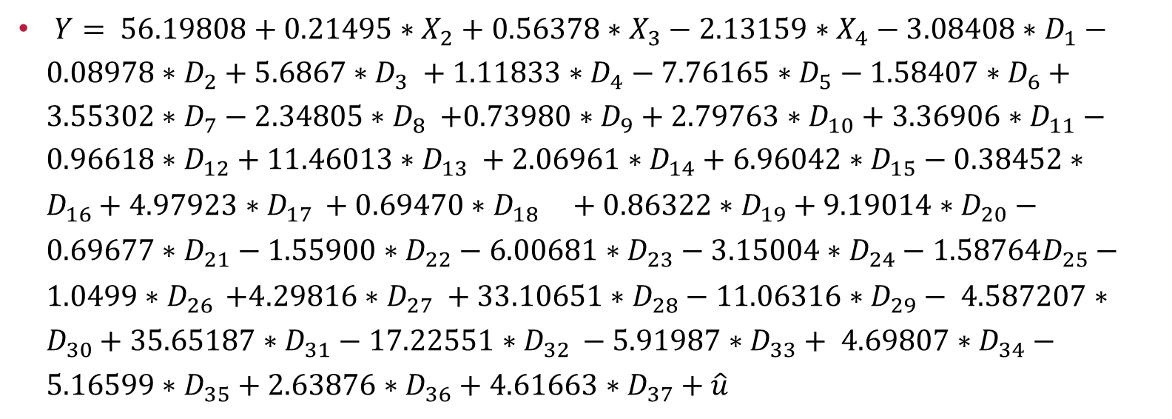
MODEL
$Y= 56.19808+0.21495∗X_{2}+0.56378∗X_{3}−2.13159∗X_{4}−3.08408∗D_{1}−0.08978∗D_{2}+5.6867∗D_{3} +1.11833∗D_{4}−7.76165∗D_{5}−1.58407∗D_{6}+3.55302∗D_{7}−2.34805{∗D}_{8} +0.73980∗D_{9}+2.79763∗D_{10}+3.36906∗D_{11}−0.96618∗D_{12}+11.46013∗D_{13} +2.06961∗D_{14}+6.96042∗D_{15}−0.38452∗D_{16}+4.97923∗D_{17­ }+0.69470∗D_{18} +0.86322∗D_{19}+9.19014∗D_{20}−0.69677∗D_{21}−1.55900∗D_{22}−6.00681∗D_{23}−3.15004∗D_{24}−1.58764D_{25}−1.0499{∗D}_{26­ }+4.29816∗D_{27} +33.10651∗D_{28}−11.06316∗D_{29}− 4.587207∗D_{30}+35.65187∗D_{31}−17.22551∗D_{32 }−5.91987∗D_{33}+ 4.69807∗D_{34}−5.16599∗D_{35}+2.63876∗D_{36}+4.61663∗D_{37}+\hat{u}$

Slide 6
Conclusion and Recommendations
Chicago is the most prone to delay , Atlanta performs well despite being the busiest airport
Best days to travel are Wednesdays
Best time to travel is in between 6:00 am to12 noon.
Winters have a significant impact on delay
United and American Airlines are more prone to delay than the other airlines

Slide 7
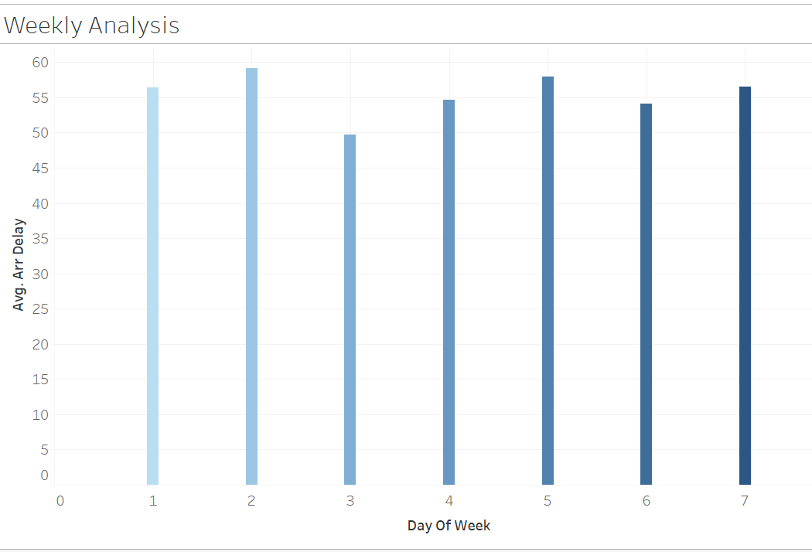

Slide 8
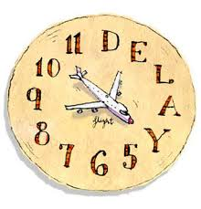
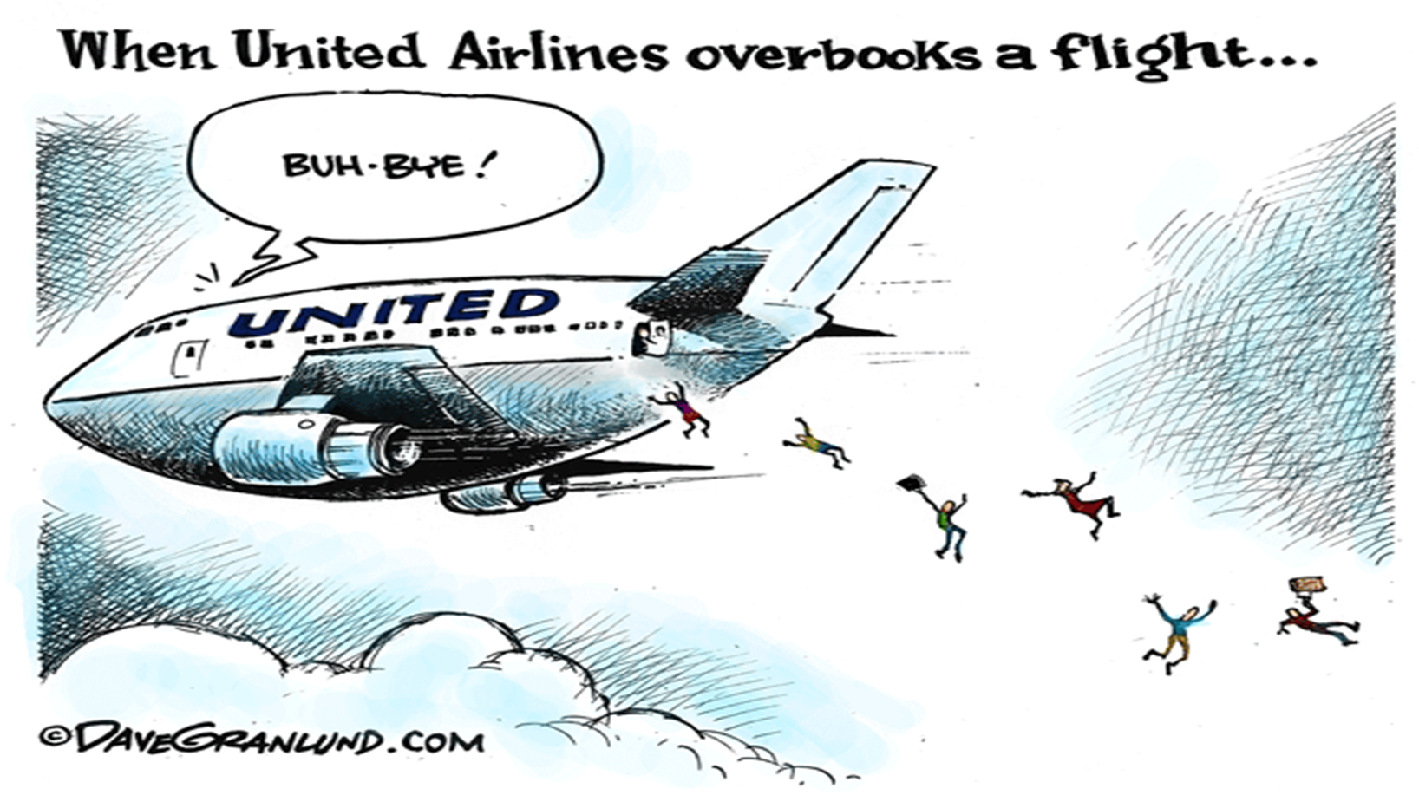
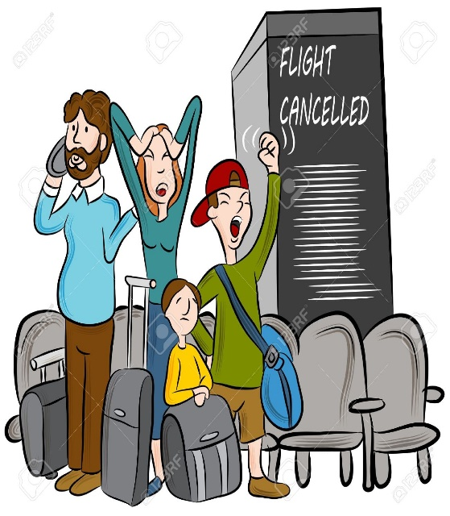

Slide 9
Analysis of yearly trend
The motivation behind gauzing the trend of the flight delay, spanning across various years is to seek the performance of an airline over time.
The predictors chosen for the analysis are percent of flight delayed due to carrier, weather, national aviation system and security.
Used dummy variables for depicting the years from 2013 to 2016.
Applied Fixed effect model:
Y = -245.31 + 94.49661*X1 + 236.30*X2 + 52.94171* X3 + 25.754 * X4 + 80.70629 * D1 + 97.641 * D2 + 102.76 * D3 + u

Slide 10
Testing of regression
Found multicollinearity problem between carrier_ct and late_carrierct .
There was no problem of heteroscedasticity in the regression by checking through White’s test.
Although expected being a time series problem, there was no issue of auto-correlation too. Durbin-Watson value came to be 1.98.

Slide 11
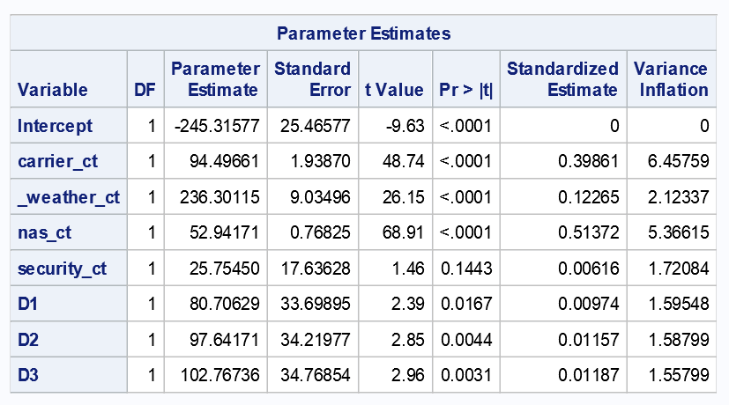

Slide 12
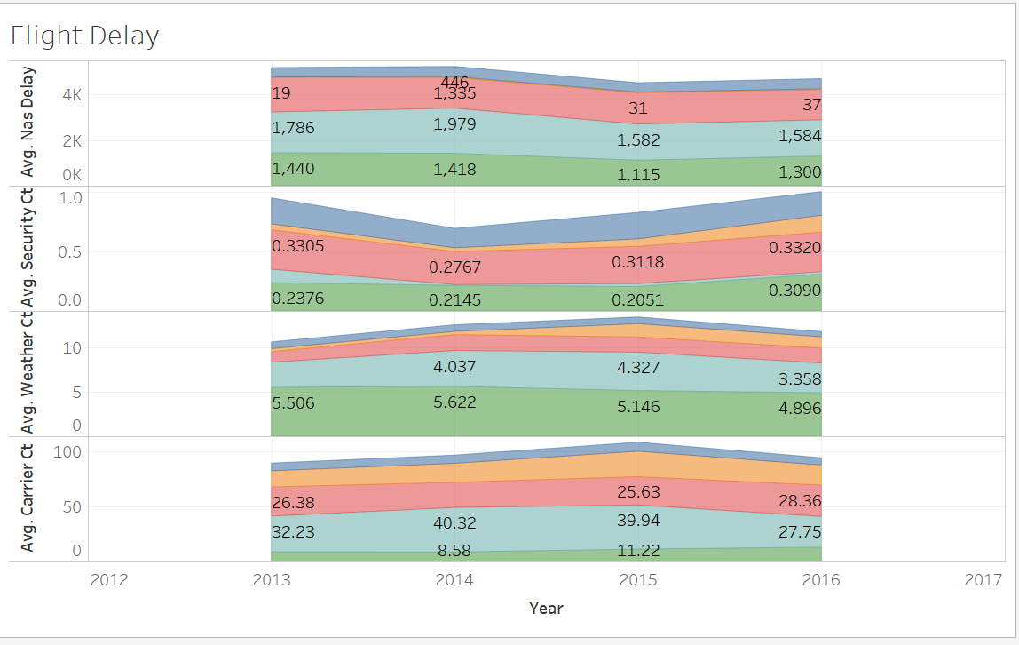
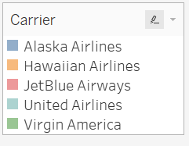
Findings
Yearly trends for all the important airlines:

Slide 13
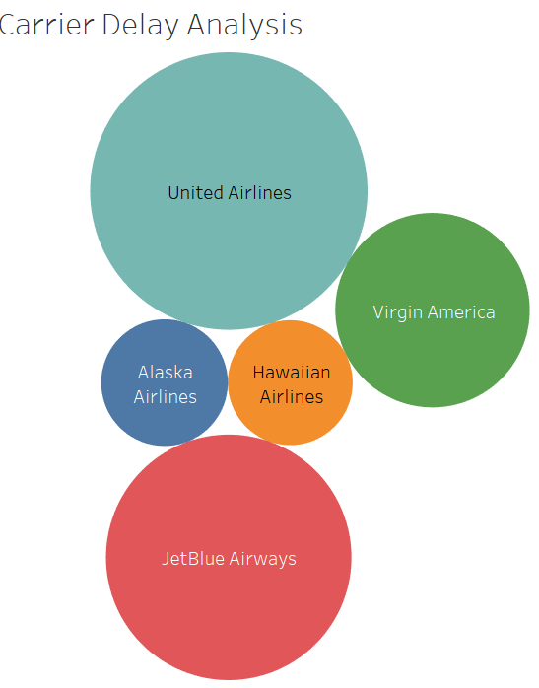
Findings..
Granular yearly analysis for Alaska Airlines

Slide 14

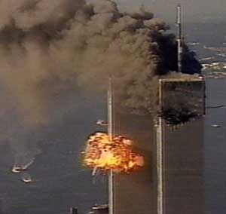
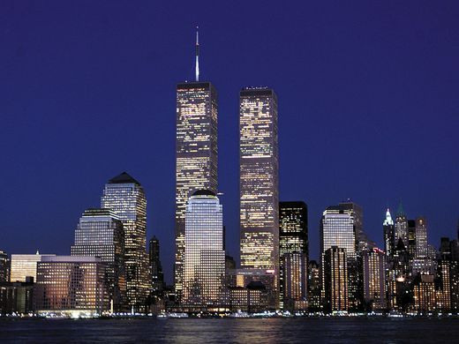

Slide 15
Impact of 9/11 on AIRLINES DELAY
Post 9/11The Aviation and Transportation Security Act was passed.
The Transportation Security Administration (TSA) is an agency of the U.S. Department of HomelandSecurity that has authority over the security of the traveling public in the United States. It was created as a response to the September 11, 2001 attacks.
Implemented procedures which included stricter guidelines on passenger and luggage screening. (Banning liquids, removing shoes)

Slide 16
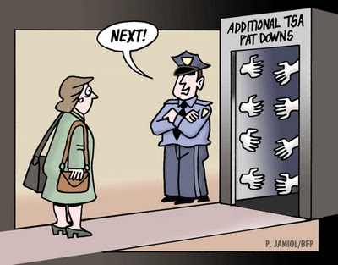
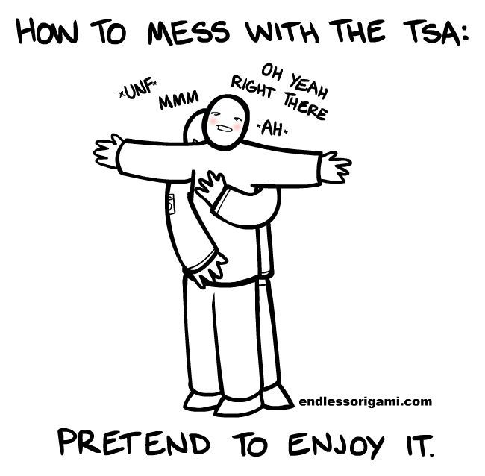

Slide 17
Data Description
Data for only New York State only(Origin\Destination)
Dummy variables for each month. (Sep,Oct,Nov,Dec,Jan,Feb)
All the airport throughout New York State present in the data set.
Distance between the airports
Duration: Aug 2001 to Feb 2002
Regression Equation,
Dep_delay= β1+ β2Sep01+ β3Oct01+ β4Nov01+ β5Dec01+ β6Jan02+ β7Feb02 +β8Distance+ u

Slide 18
Results
All the independent dummy variables except September came as significant. (Although delay was there)
Large number of flights cancelled in September 2001.
Months of November and December also showed a little rise in delay which we think can be contributed to the strict security procedures accepted under TSA after 2 months of 9/11 attack.

Slide 19
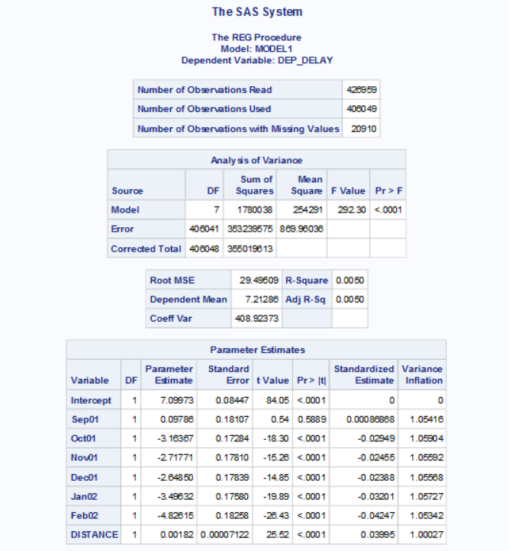

Slide 20
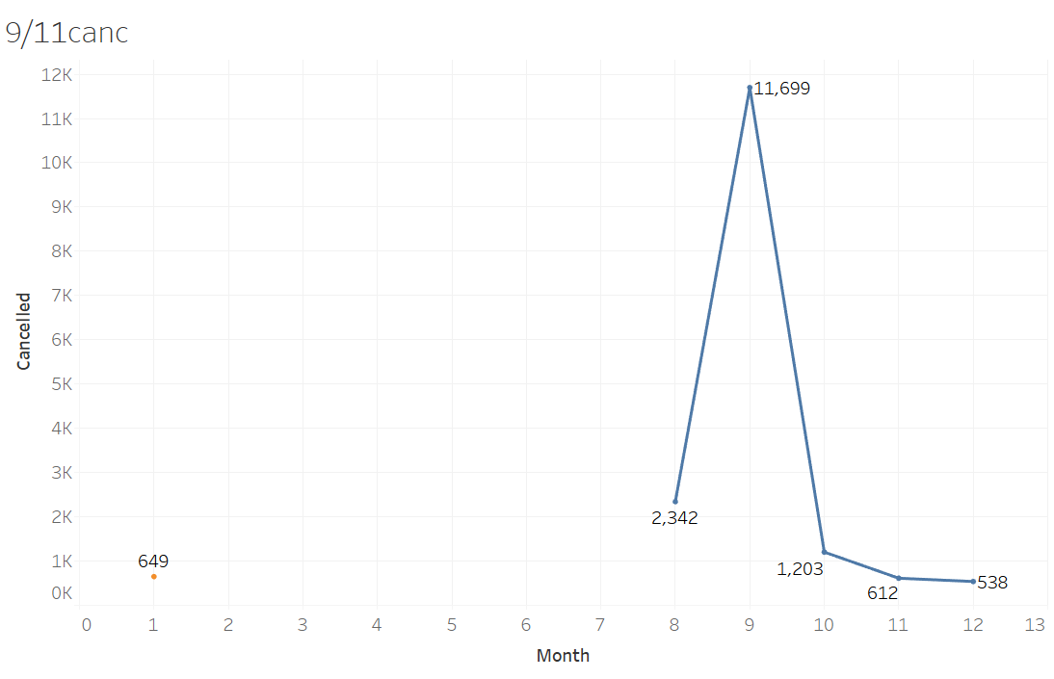

Slide 21
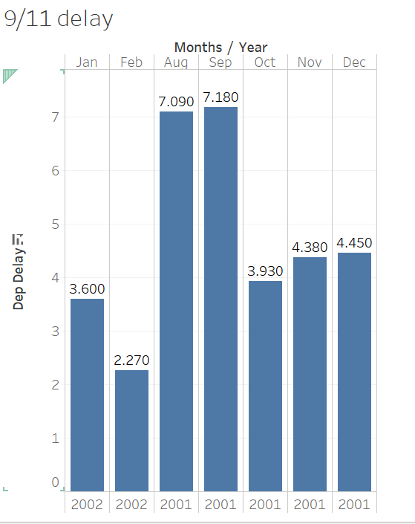

Slide 22
